Slide 1



Mean Sea Level Forecasting
Linear Regression, Seasonal Naïve, and Time Series Forecasting
Thad Hoskins, Gina McFarland, and Paul O’Leary

Slide 2

Research Question:
Given our data set of mean sea level spanning 27 years, can we apply a method that accurately models this data?

Slide 3
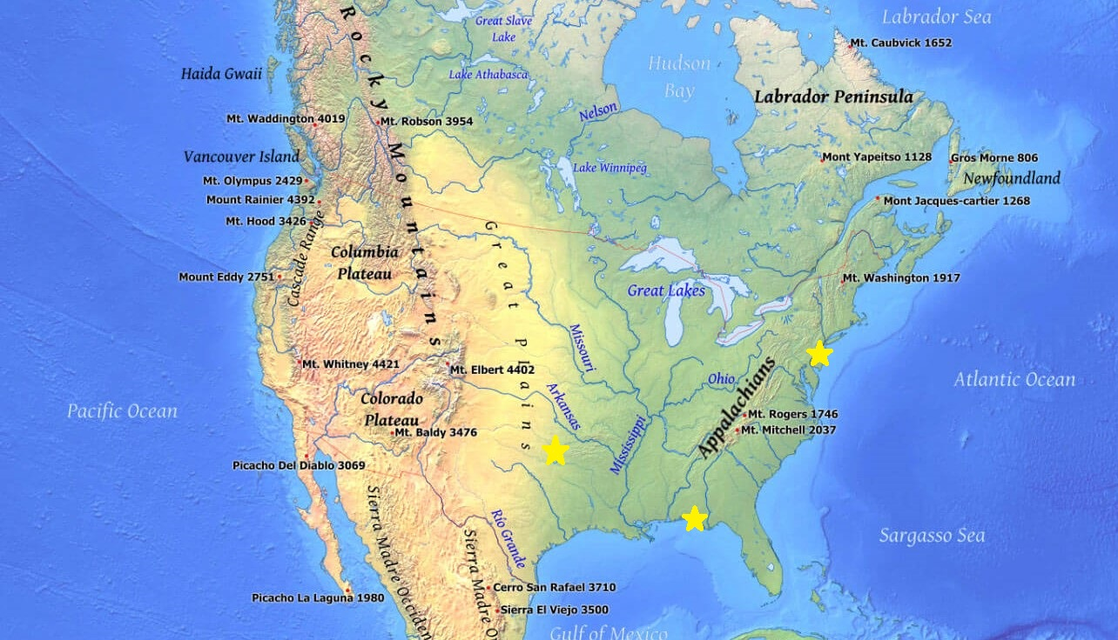
Why Do Rising Sea Levels Matter?
Notes:
On a personal level, we are interested in this data because of our current geography. Paul and Gina currently live near the beach; Paul in Delaware and Gina in Florida. Paul experiences flooding on a regular basis near his place. This brought about the question - how long until this place is underwater? And Thad would just very much like his property in Texas to not become ocean front property.

Slide 4

Why Do Rising Sea Levels Matter?
Notes:
On a global level, coastal communities around the world are threatened by rising sea levels. Around 10% of the world’s population live in coastal areas less than 10 meters above sea level (2017). Sea levels have risen over 8 inches since 1880. 3 of those inches have been in the past 25 years alone (2019). We see this rise in our dataset, including the 3.2 mm added to oceans levels each year.
Ref:
Nunez, C. (2019, February 27). Sea level rise, explained. Retrieved August 18, 2020, from https://www.nationalgeographic.com/environment/global-warming/sea-level-rise/
United Nations. (2017, May). Retrieved August 17, 2020, from https://www.un.org/sustainabledevelopment/wp-content/uploads/2017/05/Ocean-fact-sheet-package.pdf

Slide 5

Data
NASA MEaSUREs Program
1006 data points spanning 27 years with 36 samples per year
Data variables used in analysis:
Time: 1993.0115260
Mean Sea Level: -37.24 mm
HDR Header_End---------------------------------------
0 11 1993.0115260 466462 337277.00 -37.24 92.66 -37.02 -37.24 92.66 -37.02 -37.55
0 12 1993.0386920 460889 334037.31 -40.35 95.39 -38.20 -40.34 95.39 -38.19 -38.06
0 13 1993.0658580 472123 342416.09 -40.17 92.29 -38.28 -40.16 92.29 -38.27 -37.60
0 14 1993.0930250 421377 306050.59 -41.92 96.20 -38.56 -41.89 96.19 -38.54 -37.45
Notes:
The data contains Global Mean Sea Level (GMSL) variations computed at the NASA Goddard Space Flight Center. The data was collected as a part of the Making Earth System Data Records for Use in Research Environments (MEaSUREs) Program, in which NASA uses satellite sensors to gather data on the oceans, land, atmosphere, ecosystems, and the interactions of all of these (2020).
Time is given in year with fractions of a year
units are global mean sea level (GMSL) (Global Isostatic Adjustment (GIA) not applied) variation in (mm) with respect to 20-year TOPEX/Jason collinear mean reference

Slide 6
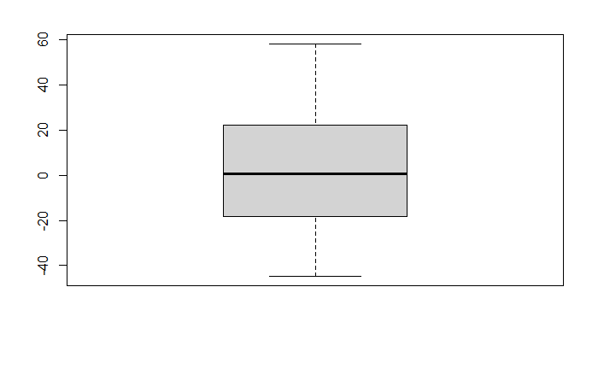
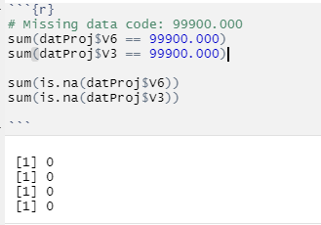
Data Preparation
No missing data in selected variables
No outliers
Chose to use raw data instead of smoothed /
analyzed data
Time series / seasonal naïve required equal time
intervals
Notes:
Col1 contains the method from which the data was obtained, Col 2 is the file cycle number, Col 3 is the date at which the measurement was taken, Col 4 was the number of observations, Col 5 was the number of weighted observations, Col 6 contains the raw data, and columns 7-12 have varying analyses on the raw data. We concluded that it was best to study the raw data as opposed to data that has had any sort of manipulation or filtering for this analysis.

Slide 7
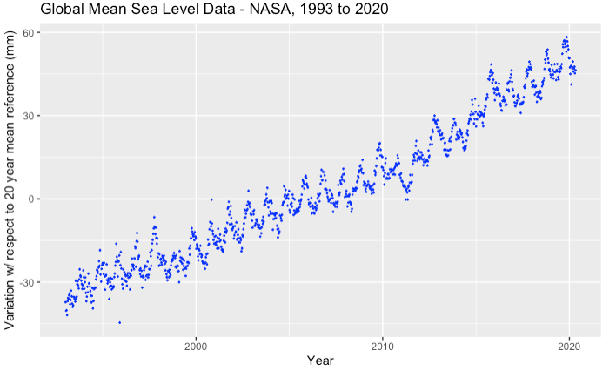
Data Visualization
Basic Scatter Plot of Raw Sea Level Data (mm) with respect to 20-year mean reference:

Slide 8
Linear Regression
Model creates a prediction by fitting a linear equation to observed data
Uses lm function
lm(predictor var ~ independent var, datasource)
Use output to test model assumptions
1. Independent observations
2. Response variable must be normally distributed
3. No autocorrelation
4. Homoskedastic
Notes:
homoskedasticity, the variance of the residuals must be the same for any X.

Slide 9
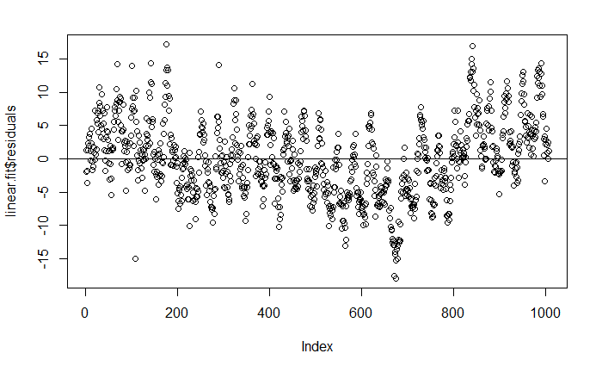
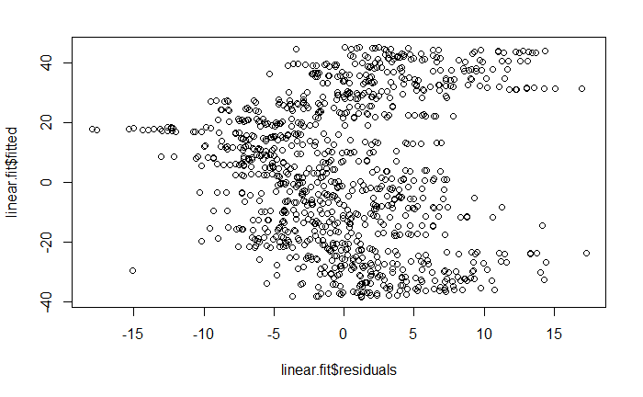
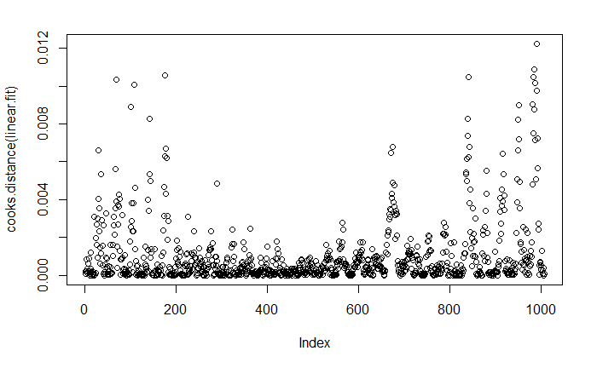
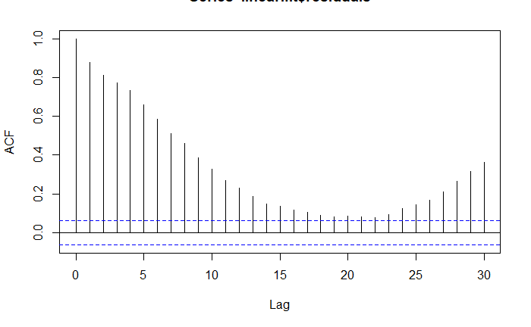
Linear Regression
Plot 1
Plot 2
Plot 3
Plot 4
Linear Regression is not appropriate for this data.
Notes:
In Plot 1, the residuals of the function do not appear randomly distributed as is required for linear regression to be used to create inferences. This implies that the variables are not independent.
Plot 2 is the fitted vs. residuals plot. This plot shows non-linearity, unequal error variances, and outliers. For the linear regression model assumptions to hold valid, this plot should have a horizontal band that is distributed evenly around the 0 line with no one residual standing out from the others. This is not the behavior shown in the Plot with the points grouped and with several outliers.
Plot 3 is a plot of Cook’s distances. These are influential points that may affect prediction outcomes. This data has a number of points with high Cook’s distances.
Finally, Plot 4 shows autocorrelations. Autocorrelations occur when the residuals are not independent of each other, which is a violation of the assumptions of the linear regression model. Based on these issues, we are unable to model this data with linear regression.

Slide 10
Seasonal Naïve Forecasting
Naïve Forecasting
future data will look like past data
Baseline, assumes the data is relatively unchanging

Slide 11
Seasonal Naïve Forecasting
Naïve Forecasting
future data will look like past data
Baseline, assumes the data is relatively unchanging
Seasonal Naïve Forecasting
assumes the data changes periodically
Christmas sales
Summer ice cream sales

Slide 12
Seasonal Naïve Forecasting
Naïve Forecasting
future data will look like past data
Baseline, assumes the data is relatively unchanging
Seasonal Naïve Forecasting
assumes the data changes periodically
Christmas sales
Summer ice cream sales
Random Walk Model
Non-stationary
Assumes future cannot be predicted
The time series is not random
Why use it here?

Slide 13
Seasonal Naïve Forecasting
rwf(d, h, drift, level) *
d : time Series Data; frequency of 36.8
h: length of forecast; in this case, duration of last 30% of the data (test)
drift: True; allows for the data to change
level: sets how narrow or wide the prediction may be
* rwf() is a wrapper for snaive() with drift

Slide 14
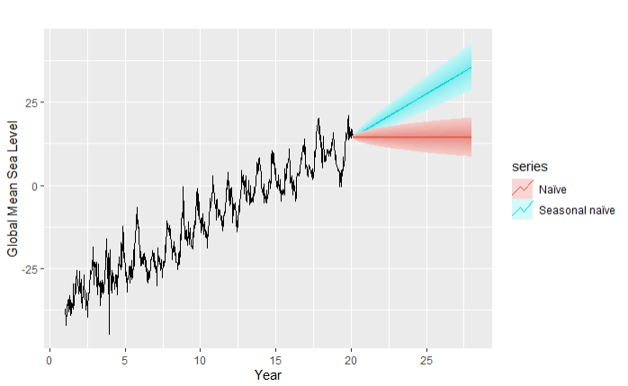
Seasonal Naïve Forecasting
Notes:
The naive models could not discern a seasonal pattern in the data, but could predict a trend based on the the past data. As shown, the Season Naive with drift (blue) assumes the data to similar but increasing (drift). The Naive model (red) assumes data will be the same.

Slide 15
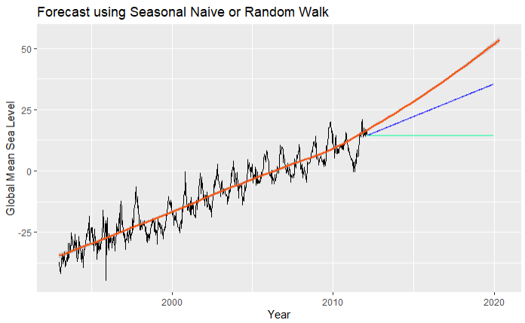
Seasonal Naïve Forecasting
Notes:
Using the same models, we may now test their predictive ability by adding a smoothed trend line. As you can see, the prediction accurately utilized the past, but does not anticipate a strong enough increase.

Slide 16
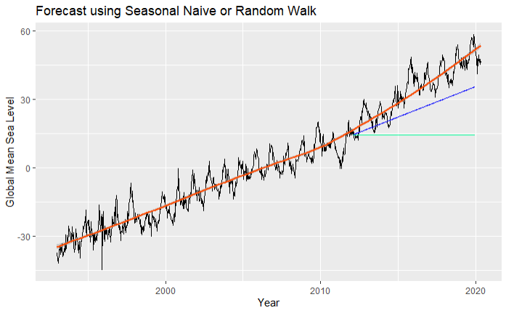
Seasonal Naïve - Actual vs Forecast
Notes:
Adding in the actual data, keeping the trend line and the prediction, we see that the prediction failed to accurately model the data

Slide 17
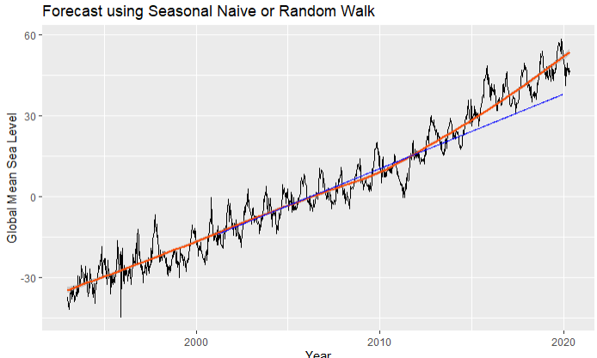
Seasonal Naïve - Timing is everything
Notes:
Last graph. We had a guess after seeing the earlier graphs that perhaps we were just unlucky in our chosen point to forecast. This graph goes back much earlier, 2001 rather than 2012, in time to begin the projection. You can see that the forecast is dead-on accurate until about 2012, when the mean sea level increase slopes upward. The actual data departs from the projection at this point, as it could not predict the upturn.
8 years of data was sufficient to forecast, assuming the trend remained.

Slide 18
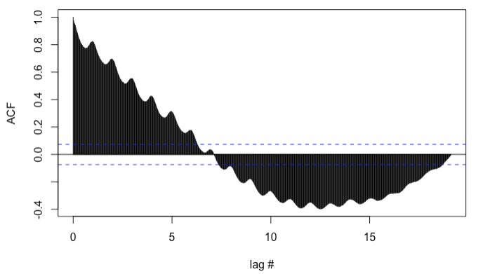
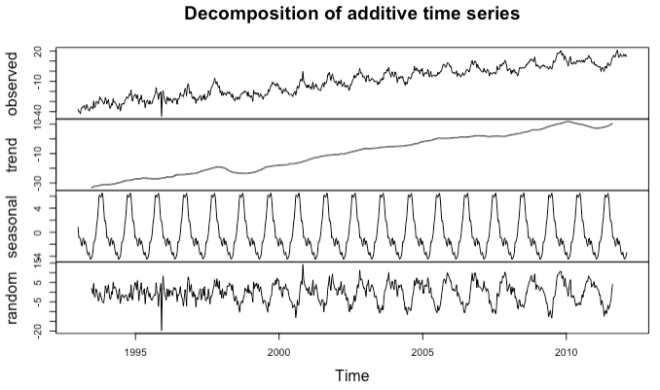
Time Series
Aspects of Time Series data to Analyze
Is the data Additive or Multiplicative?
Additive
Is the data Stationary?
Use Augm. Dickey-Fuller Test (adf.test)
or check Autocorrelation (acf):
NOT Stationary
Is the data Seasonal?
Decomposition (decompose) breaks
TS Data into components:
Definitely Seasonal
Notes:
This data is “Additive” - each “year” of data has roughly the same min and max - it is not changing multiplicatively.
First graph shows Autocorrelation and “lags” - correlation of current steps with previous time steps. The MEAN is changing over time - the data is NOT Stationary.
Second graph: Decomposition shows Observed, trend, seasonal, and “noise” components of the data. Decompose uses a “moving average” to determine the trend - that average is removed from the time series. The seasonal component is again averaged, centered and removed. Everything left over is the “noise” or the remainder. ALSO this data is “Additive” - each “year” of data has roughly the same min and max - it is not changing multiplicatively.

Slide 19
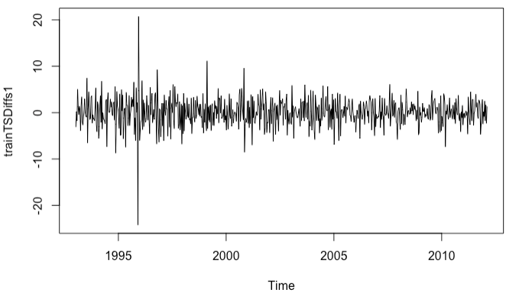
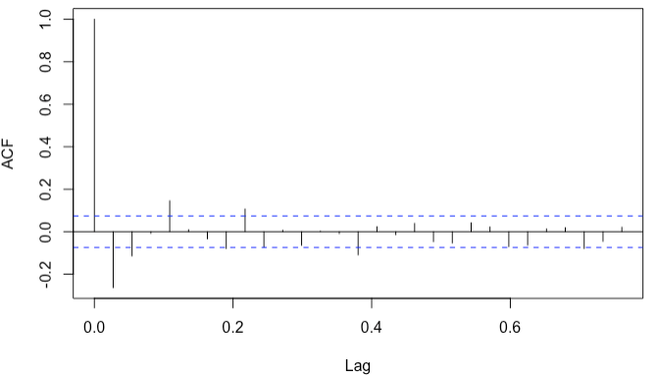
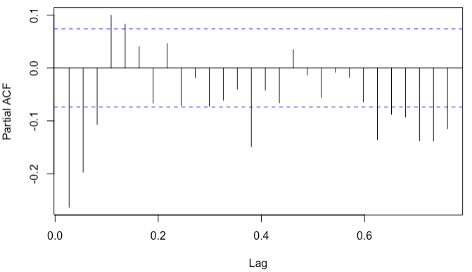
Time Series Forecasting
ARIMA (Autoregressive Integrated Moving Avg.)
ARIMA based on AR (auto regressions) and
MA (moving average) process
ARIMA(p,d,q)
d - Number of Differencing (diff) steps
Data must be stationary.
p - Estimated from PACF of differenced data
AR component
q - Estimated from ACF of differenced data
MA component
Seasonal ARIMA adds seasonal components for
p and q for the seasonal component of the data.
Notes:
I decided to try: ARIMA is a generalized version of ARMA - ARIMA works on differenced data, whereas ARMA works with the original data. ARIMA(p,d,q) p: The number of data points to lag in the atoregression of the calc. p: run PACF (partial autocorrelation) count where the lags trend towards 0 and fall within the confidence interval. For q: use ACF, to see the lag of the error component of the data. With these components you can run the ARIMA function which will estimate an AICc and BIC (Akaike and Bayesian Information Criteria.) You can run many trials to minimize these statistical errors of the results. This can be a tedious process.

Slide 20
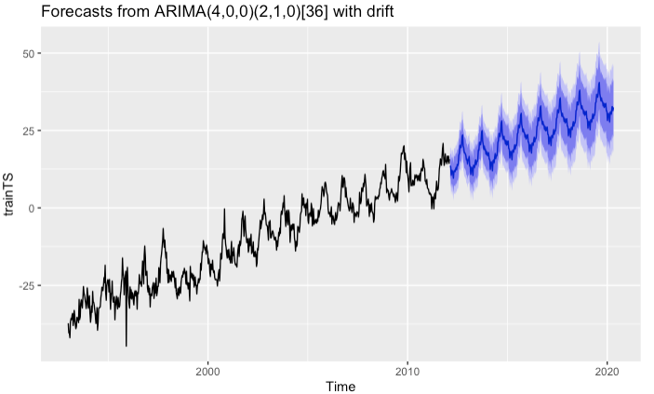
Time Series Forecasting
Resulting forecast for the data after running “auto.arima” in R
Notes:
Luckily R provides an auto.arima function, which steps through many trials, to determine the proper settings for the arima function. The black shows the training data, and the blue is the future forecast.
And this looks pretty good, until...

Slide 21
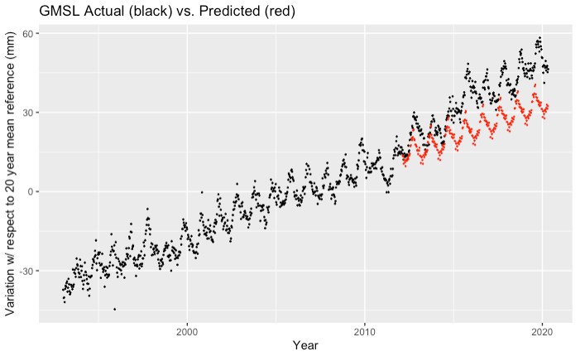
Results
The Seasonal ARIMA model predicted results in red, over the actual data.
Notes:
When we overlay the graphs, the prediction from the Seasonal ARIMA model absolutely can not account for the slight change in how quickly sea levels are rising - as Thad discovered - right near where we chose to split the data.

Slide 22
Conclusions
Results for model accuracy tests for the Seasonal ARIMA Prediction model.
MAE (Mean Absolute Error): 11.083. The mean of the differences between actual and predicted data points is 11.083 units (mm). The relative size of the error may not be obvious.
R-Squared: 0.759. R-Squared is the percentage of the variation between predicted and actual points explained by a linear model. Values are always between 0 and 100%. In general, the higher the R-Squared value, the closer the model predicts the data.
Based on our Training Data, the Model worked as hoped. However, as shown on a Seasonal Naive model graph, the Test Data set shows a noticeable increase in the rate of change around 2012. This happens to be near the 70%/30% split, which accounts for the large MAE.
* The ocean has risen 8 inches since 1880 - 3 of those inches since 1994. This suggests that the yearly increase in Sea Levels may continue to grow faster.
Notes:
Given what we have seen from how the actual model trended up near where we chose to split the data, these results for the tests are not surprising.
MAE - By Relative size, for data that has very large values, an MAE of 11 would not be significant.
(MAPE - A percentage version of the MAE, basically)
R-Squared - In general, the higher the value, the closer the model predicts the data. But this gets complicated depending on the data.
5 inches from 1880-1994 is a rate of .044 inches/year. 3 inches in 26 years since 1994 is almost .12 inches/year

